Slide 1
Client: XYZ Grocery Store
Report on recommending popular combo offers and discounts for Customers of grocery store.
Using Market basket analysis.
by:
Romil Consultants.

Slide 2
Contents:
1 : Problem Statement/Business Problem.
2 : Exploratory Analysis of data & an executive summary.
3 : Market Basket Analysis (Association Rules).
4 : Associations Identified (Support, Confidence and Lift) Values.
5 : Possible Combos with Lucrative Offers.
6 : Recommendations.

Slide 3
1 : Problem Statement/Business Problem.
A Grocery Store shared the transactional data with us. Our job is to identify the most popular combos that can be suggested to the Grocery Store chain after a thorough analysis of the most commonly occurring sets of items in the customer orders. The Store doesn’t have any combo offers. Can you suggest the best combos & offers?
We will be performing Exploratory Data Analysis to understand the Given Data and based on that We will be doing Market Basket Analysis to identify the Popular combos and offers for the Grocery Store

Slide 4
2 : Exploratory Analysis of data & an executive summary.
Date | Order_id | Product
01/01/2018 | 1 | yogurt
01/01/2018 | 1 | pork
01/01/2018 | 1 | sandwich bags
01/01/2018 | 1 | lunch meat
01/01/2018 | 1 | all- purpose
01/01/2018 | 1 | flour
01/01/2018 | 1 | soda
01/01/2018 | 1 | butter
01/01/2018 | 1 | beef
01/01/2018 | 1 | aluminium foil
Our Data looks like :

Slide 5
information on data:
Given Data is having 20641 Rows and 3 Columns which are (Date, Order_id and Product).
Date : It is the time when product purchased by customer.
Order_id : It is the unique Id which defines the number of purchases by every single customer.
Product : Name of Product.

Slide 6
Summary of data:
There are no Missing Value.
There are 4730 Duplicates which we do understand that this numbers are basically the Order_id and Products also.
So we will consider this duplicates for our analysis.

Slide 7
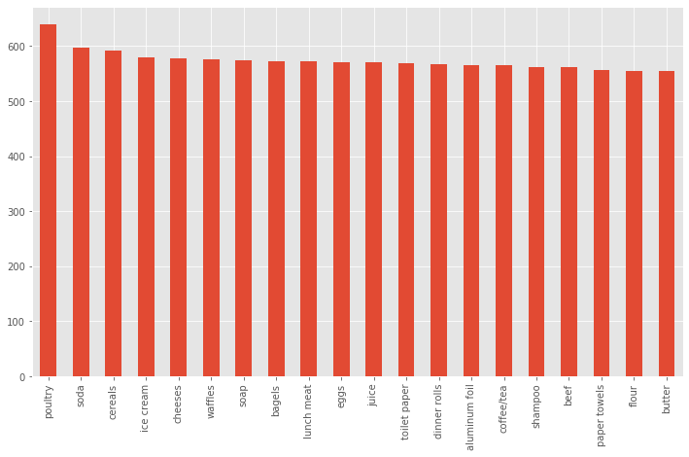
EDA on Products

Slide 8
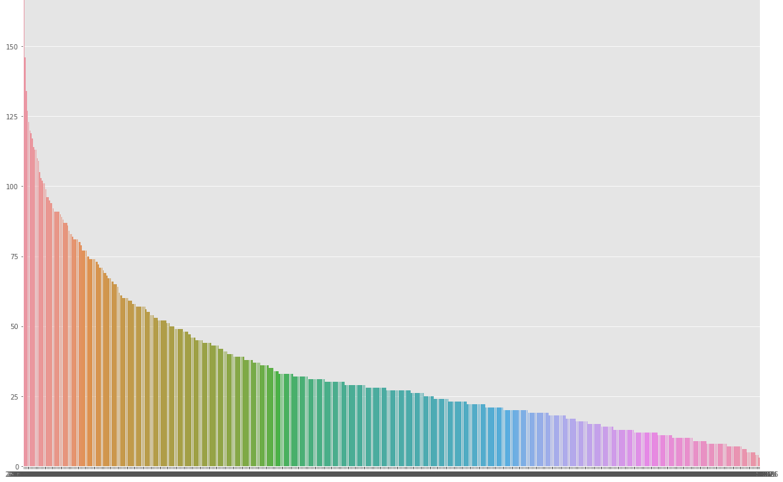
Eda on Date

Slide 9
Summary on products and date:
Products: All products are equally counted but for Poultry there are maximum numbers which is of 0.03 % of entire Product range. So we can see that Poultry products are high in range. Other products too have 0.02 to 0.028 %.
Date Counts: When we count the Date maximum purchase is from the starting of the data which is of 2019-02-08 and then there is slightly negative trend in dates.

Slide 10
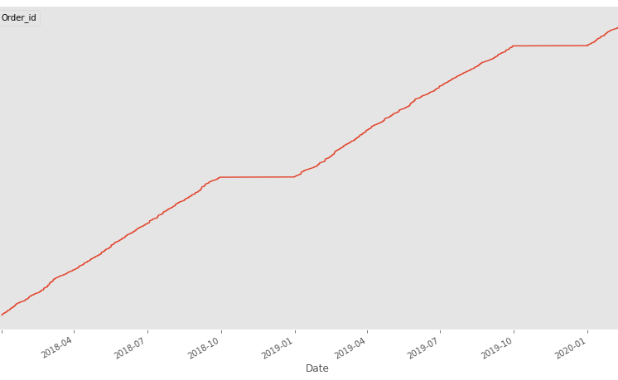
Trends

Slide 11
Summary on trends:
We can clearly see that there is High increase in Order trends and overall the Trend is on Positive/Increasing.
Every October Month we can see the Highest Orders and it is Increasing too.
After October, November to January are the Flat line Sales which is constant in this 3 months there is no Trend, Need to understand the reason behind it, weather is it Natural/Season or No discounts.
So February to October is having Trend of increasing Orders (October is the Highest)
November to January is having the Flat sales (lower than previous months) which is constant through out all the 3 years.

Slide 12
3 : Market Basket Analysis (Association Rules).
There are 3 Rules in Market Basket Analysis:
1: Support: It identifies the number of times one product has been bought in one basket irrespective of number of baskets. It should always be minimum as we will use the support of (0.1) means 10 %.
2: Confidence: By using Conditional probability it calculates the chances of Support given (which is of 10% as per the above) that 10% of chance that Product is present in every Basket.

Slide 13
Association rules cont.
So combination of Support and Confidence gives us the probability that how much one Specific Product can be recommended.
3: Lift: It provides weightage on every single product present in the Basket which helps us to determine which is the top product which can be recommend if there are similar Baskets.
It goes with Descending order of items.

Slide 14
Threshold values:
For Support : (0.1) 10 % :
Which assumes that 10 % of time One product cannot be bought in every customer Basket, which means that 10 % of chance of buying the same one product in every customer's basket, and 90 % of chance that every basket will have different products.
For Confidence: (0.5) 50 % :
Which means that there is chance of 50 % that every product is available or present in each basket based on our Support value which is of (10% of times every basket has same product).

Slide 15
Calculated support values:
 | support | itemsets
0 | 0.37489 | (all- purpose)
1 | 0.384548 | (aluminum foil)
2 | 0.385426 | (bagels)
3 | 0.37489 | (beef)
4 | 0.367867 | (butter)
... | ... | ...
698 | 0.172959 | (waffles, toilet paper)
699 | 0.162423 | (yogurt, toilet paper)
700 | 0.149254 | (waffles, tortillas)
701 | 0.152766 | (yogurt, tortillas)
702 | 0.173837 | (waffles, yogur

Slide 16
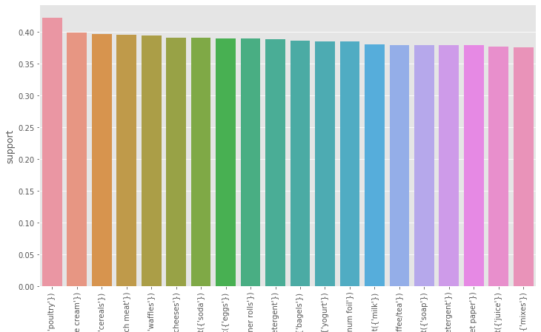
All Products Support values

Slide 17
4 : Associations Identified (Support, Confidence and Lift) Values in Tabular format.
antecedents | consequents | antecedent support | consequent support | support | confidence | lift | leverage | conviction
(lunch meat, sandwich loaves) | (individual meals) | 0.14662 | 0.375768 | 0.08253 | 0.562874 | 1.49793 | 0.02743 | 1.428037
(individual meals) | (lunch meat, sandwich loaves) | 0.375768 | 0.14662 | 0.08253 | 0.219626 | 1.49793 | 0.02743 | 1.093553
(spaghetti sauce, poultry) | (dinner rolls) | 0.171203 | 0.388938 | 0.09921 | 0.579487 | 1.48992 | 0.03262 | 1.453136
(dinner rolls) | (spaghetti sauce, poultry) | 0.388938 | 0.171203 | 0.09921 | 0.255079 | 1.48992 | 0.03262 | 1.112597
(ketchup, cheeses) | (sandwich loaves) | 0.160667 | 0.349429 | 0.08253 | 0.513661 | 1.47 | 0.02639 | 1.33769
Top 5 Identified Associations:

Slide 18
4 : Associations Identified (Support, Confidence and Lift) Values in Tabular format.
antecedents | consequents | antecedent support | consequent support | support | confidence | lift | leverage | conviction
(lunch meat) | (pasta) | 0.395083 | 0.371378 | 0.14223 | 0.36 | 0.96936 | -0.0045 | 0.982221
(milk) | (waffles) | 0.380158 | 0.394205 | 0.14311 | 0.376443 | 0.95494 | -0.00675 | 0.971515
(waffles) | (milk) | 0.394205 | 0.380158 | 0.14311 | 0.363029 | 0.95494 | -0.00675 | 0.973109
(butter) | (beef) | 0.367867 | 0.37489 | 0.12818 | 0.348449 | 0.92947 | -0.00973 | 0.959418
(beef) | (butter) | 0.37489 | 0.367867 | 0.12818 | 0.34192 | 0.92947 | -0.00973 | 0.960573
Bottom 5 Identified Associations:

Slide 19
How values are calculated:
Support Value Calculated:
As our Threshold Value for Support is 0.1 (10%).Hence we could see that our Support Value is ranging from 0.08 to 0.12 which means 10% of time every product each product is present in every Basket.
Confidence Value Calculated:
As our Confidence Value is ranging from 34 % to 56 %
which means that there is chance of 34% to 56% that every product is available or present in each basket based on our Support value which is of (10% of times every basket has same product).

Slide 20
How values are calculated:
Lift: It calculates which Product/Item can be first recommend to the Basket based on the Items present in the existing basket, Suppose if one basket has 2 products and other basket also has same 2 products so depending upon the LIFT value whichever product will have the HIGHER LIFT value system will recommend that product first.
So Confidence value gives us Probability/Chance how much our Support Value (10%) which we assumed about 10 percent of chances that every basket has same product is True or not.
How much our assumption on Support value is possible, Confidence gives us the Probability.

Slide 21
5 : Possible Combos with Lucrative Offers.
Product | Combo with | Lift Value
Lunch Meat & Sandwich Loaves | Individual Meals | 1.49
Spaghetti Sauce & Poultry | Dinner Rolls | 1.48
Ketchup & Cheeses | Sandwich Loaves | 1.47
Juice & Dinner Rolls | Spaghetti Sauce | 1.46
Poulty & Aluminium Foil | Juice | 1.44
Beef & Soda | Eggs | 1.43

Slide 22
Discount offers/Combos:
Buy 3 and get 1 Free Sandwich Loaves.
20 % Discount on any Poultry Item.
Buy 3 Dozens of Eggs and get 1 Spaghetti Sauce Free.
Buy 2 Dinner Rolls and get 50 % discount on Soda.
Buy 3 Ketchup at Price of 2.
Purchase any item above 1000 (INR) and get one Aluminium coil absolutely FREE.

Slide 23
Recommendations:
People are highly active towards the Poultry products, hence store can put this products in one dedicated section.
Soda with Bakery and Eatable items and try to see which brand of soda is highly active with different bakery and eatable foods.
Check whether Ice-Cream section can be adjusted at the Entrance location or in Billing Counter.
Make one day for flat price on those products which are sitting in Inventory.
Have one Display at the Entrance for the above Combos/Offers.
Send all the Combo/Offers to the Loyal customers which have past history of buying those products via mail, message or by calling.
See if you can get in Bulk for those products which are selling fast.

Slide 24
Reference:
Coding is done in Python and same Jupyter notebook is also given to you.
Python packages used in coding are:
Numpy, Pandas, Seaborn, Matplotlib.
Python packages used in Market Basket Analysis are:
Transaction Encoder, apriori, association_rules from mlxtend preprocessing and frequent_patters.

Slide 25
Thank-you
Romil Consultants,
Email: romil@abc.com
Contact: 9545639955

